Slide 1


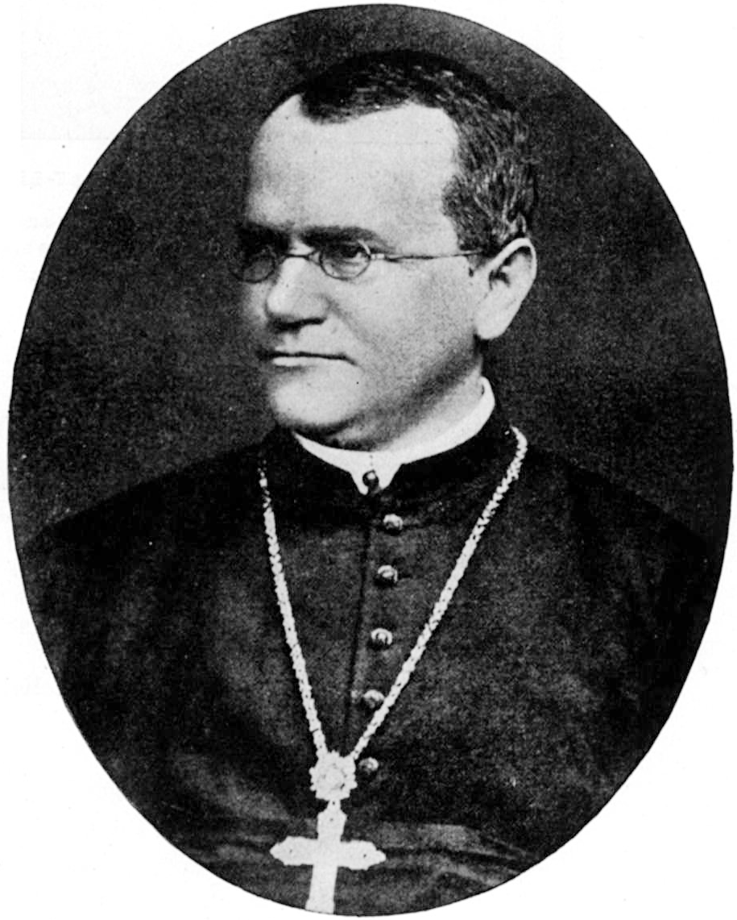
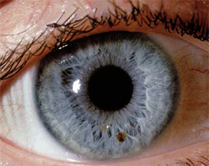
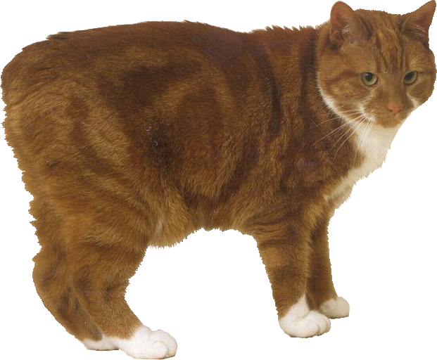

Genes & Inheritance Series: Set 4
Copyright © 2005
Version: 2.0

Slide 2

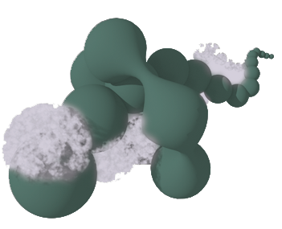



Genes and Inheritance
Genes contain the information for the production of proteins and functional RNA molecules.
Proteins are responsible for the physical expression of genes as phenotypic characteristics or traits, such as eye color.
Since genes are inherited, traits are also inherited.
Chromosome
Gene
Protein
Trait

Slide 3
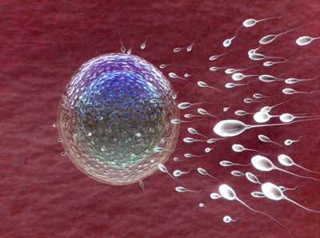
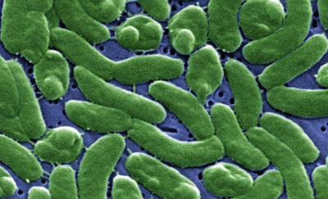

Inheritance of Traits
Sexual reproduction
  In organisms that reproduce sexually, traits are inherited through gametes.
  Gametes (sperm and eggs, or pollen and ova) are produced by meiosis.
  Offspring possess a combination of genes from both parents.
Asexual reproduction
  Barring mutation, the offspring of organisms that reproduce asexually (i.e. without meiosis) are genetically identical clones of the parent.
  In some exceptions, genetic material can be exchanged between clones.
  Example: antibiotic resistance in bacteria can be transferred via plasmid DNA.
In sexual reproduction, haploid sperm and egg unite to form a diploid zygote.
Bacteria reproduce asexually by binary fission.

Slide 4
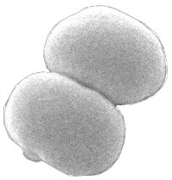
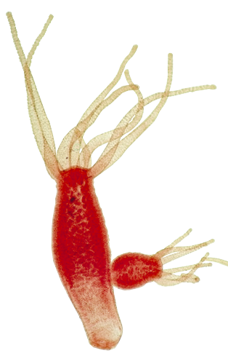
Binary Fission and Budding
Organisms such as bacteria and some single celled protists reproduce asexually by binary fission.
  Binary fission involves the single parent cell dividing into two daughter cells.
Asexual reproduction in some multicellular organisms (e.g. coelenterates such as Hydra and some plants) occurs by budding.
  In budding, part of the parent body is ‘pinched off’ to produce a small individual exactly like the parent.
Binary fission in the bacterium Staphylococcus
Budding in Hydra
New individual

Slide 5
Asexual Reproduction
In asexual reproduction, there is no exchange of genetic material between clonal lines; strains developing mutations will compete.
Generation
1
2
3
4
5
Original population
Mutant strain B
Mutant strain A

Slide 6
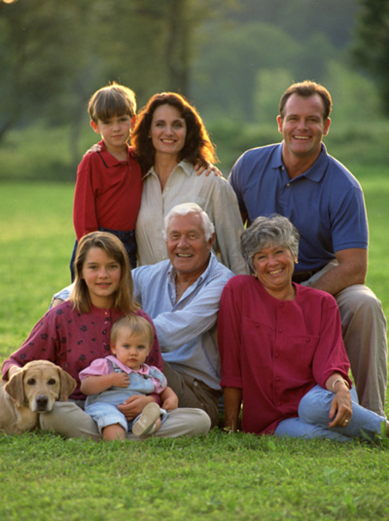
Sexual Reproduction 1
Most plants and animals reproduce through sexual reproduction, at least some of the time.
This involves genetic input from two parents.
  The random sorting of parental genes provides new combinations in each offspring.
  Except for identical twins the offspring are all unique.
  The diversity in the genetic make-up of offspring means that some may be better able to survive and reproduce in the prevailing environment.
Family resemblances can be traced through generations but, with the exception of identical twins, each individual is unique.

Slide 7
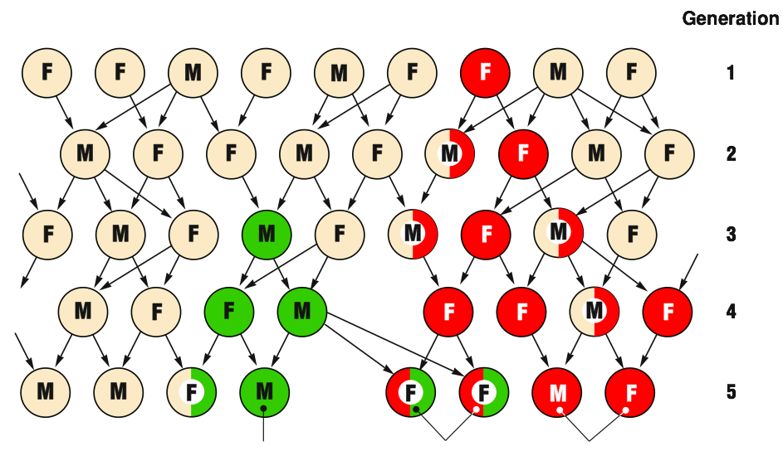
Sexual Reproduction 2
In sexually reproducing organisms, favorable mutations can combine
in a single individual and may confer a competitive advantage.
Original population
Mutant strain B
Strains combine
Mutant strain A

Slide 8
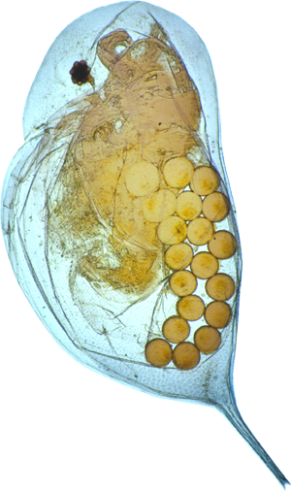
Sexual vs Asexual Reproduction
Sexual Reproduction | Asexual Reproduction
Sexual reproduction has adaptive advantages because the offspring are genetically variable. Some individuals may be better suited to the prevailing environment than others and will produce more offspring. | Asexual reproduction allows populations of well adapted clones to increase quickly in favorable environments.
 | These clones may be more vulnerable than others when the environment changes.
 | As they cannot produce variable offspring, they may be outcompeted by other better suited clonal lines.
 | Some organisms, e.g. aphids and water fleas (Daphnia), reproduce asexually most of the time, but compensate for a lack of genetic variability by introducing short periods of sexual reproduction as well.
Daphnia with eggs. These diploid eggs are produced mitotically and hatch into clones of the adult.

Slide 9
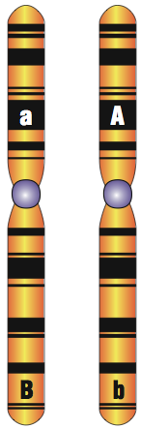
Location of Genes
Chromosome from egg
(maternal origin)
Chromosome from sperm
(paternal origin)
The position of a gene on a chromosome is the locus.
In sexually reproducing organisms, most cells have
a homologous pair of chromosomes (one from
each parent).
Chromosomes from a homologous pair have genes that control the same trait at
the same locus.
Locus for gene A
Two genes for different traits at different loci on the same chromosome
Locus for gene B
Homologous pair of chromosomes

Slide 10
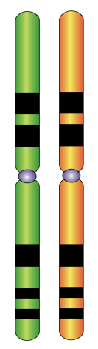
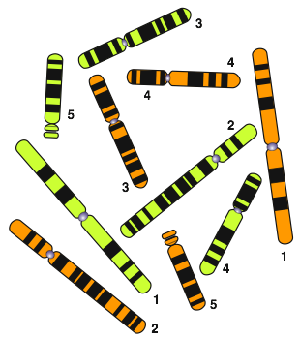
Homologous Chromosomes
This diagram illustrates the complete chromosome complement for a hypothetical organism.
It has a total of ten chromosomes, comprising five nearly identical pairs (each pair is numbered).
Paternal chromosome that originated from the sperm of this individual's father
Maternal chromosome that originated from the egg of this individual's mother

Slide 11
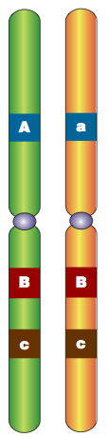
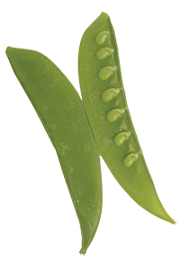
Alleles
Genes occupying the same position (locus) on homologous chromosomes are called alleles.
  Alleles are versions of the same gene that code for a variant of the same polypeptide.
  Any one individual can only have a maximum of two alleles for a given gene.
  There may be more than two alleles in a population, e.g blood groups A, B, O.
Gene A
Genes that occupy the same locus code for the same trait.
Gene B
Gene C
Maternal chromosome
Paternal chromosome
Pod color in peas
is a trait controlled by a single gene. The allele for green pods is dominant over the allele for yellow.

Slide 12
Alleles
When both chromosomes have identical copies of the dominant allele for a gene, the organism is said to be homozygous dominant for that gene.
These two different versions of gene A create a condition known as heterozygous. Only the dominant allele (A) will be expressed.
When both chromosomes have identical copies of the recessive allele for a gene, the organism is said to be homozygous recessive for that gene.
Genes occupying the same locus or position on a chromosome code for the same trait and are said to be alleles.
Maternal chromosome that originated from the egg of this person's mother.
Paternal chromosome that originated from the sperm of this person's father.

Slide 13
Gregor Mendel
Gregor Mendel (1822-1884)
was an Austrian monk who is regarded as the father of genetics.
  Mendel carried out pioneering work using pea plants to study the inheritance patterns of a number of traits (characteristics).
  Mendel observed that characters could be masked in one generation of peas but could reappear in later generations.
  What we now call Mendelian genetics is the study of inherited characteristics.

Slide 14
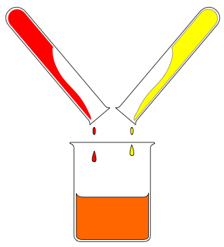
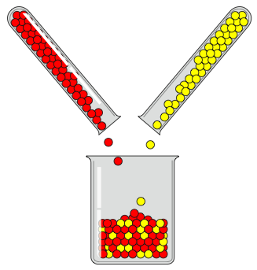
Mendel’s View of Inheritance
Parent A
Parent B
  Mendel observed that characters could be masked in one generation of peas but could reappear in later generations.
  He showed that inheritance was particulate in its nature (not blending as was previously thought).
  We now know these units of inheritance are genes.
Parent A
Parent B
Offspring
Old Idea
Blending of parental traits
Offspring
New Idea
Inherited traits behave as discrete units

Slide 15
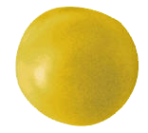
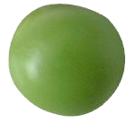
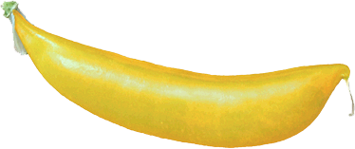
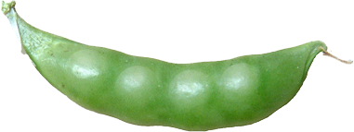
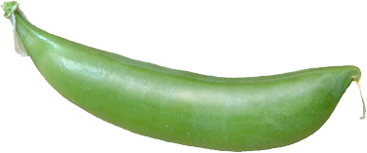
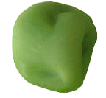
Mendel’s Pea Experiments
Mendel examined a small number of phenotypic characters or traits in peas.
With one exception, each character he studied is determined by one gene, for which there are two alleles, one dominant and one recessive.
He found that these traits were inherited in predictable ratios depending on the phenotype of the parents.
Mendel’s results from crossing heterozygous plants produced remarkably consistent phenotypic ratios.
Seed color
yellow dominant over green
Pod color
green dominant over yellow
Pod shape
inflated dominant over constricted
Seed shape
round dominant over wrinkled
Images courtesy of Newbyte.com

Slide 16
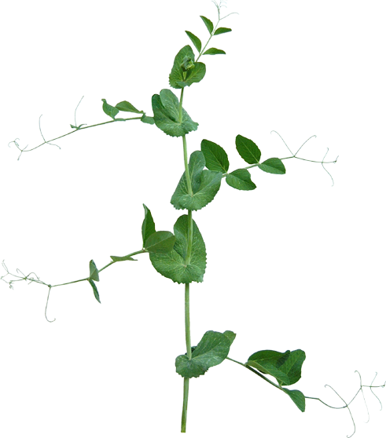
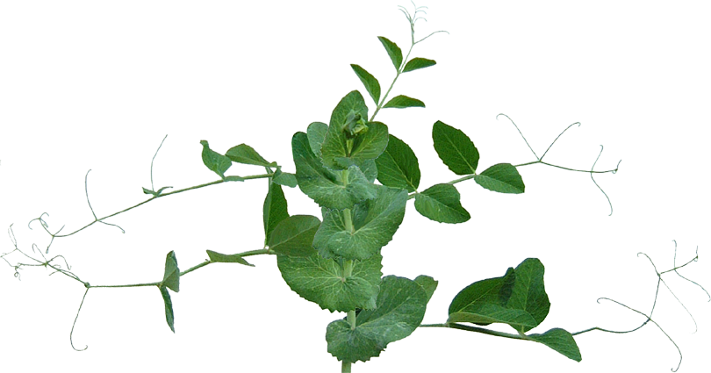
Mendel’s Pea Experiments
Stem length
tall dominant over dwarf
Images courtesy of Newbyte.com

Slide 17
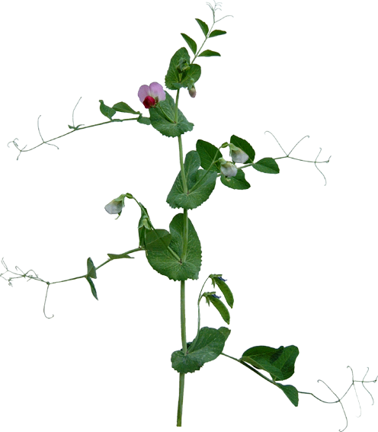
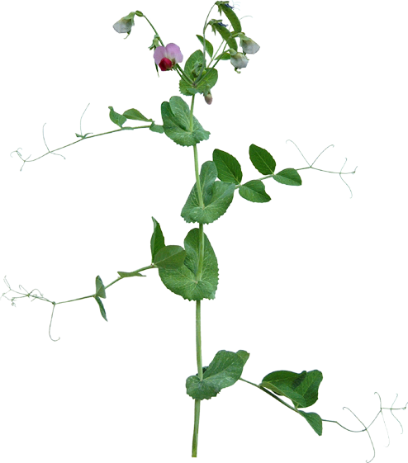
Mendel’s Pea Experiments
Axial
Terminal
Flower position
axial dominant over terminal
(geneticists since have found that flower position is actually determined by two genes)
Images courtesy of Newbyte.com

Slide 18






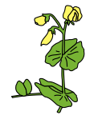
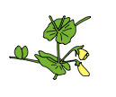


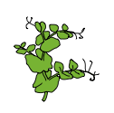
Results of Mendel’s Experiments
Seed shape | Round | Wrinkled | 5474 1850 7324 | Round Wrinkled TOTAL | 2.96 : 1
Seed color | Yellow | Green | 6022 2001 8023 | Yellow Green TOTAL | 3.01 : 1
Pod color | Green | Yellow | 428 152 580 | Green Yellow TOTAL | 2.82 : 1
Flower position | Axial | Terminal | 651 207 858 | Axial Terminal TOTAL | 3.14 : 1
Pod shape | Inflated | Constricted | 882 299 1181 | Inflated Constricted TOTAL | 2.95 : 1
Stem length | Tall | Dwarf | 787 277 1064 | Tall Dwarf TOTAL | 2.84 : 1

Slide 19
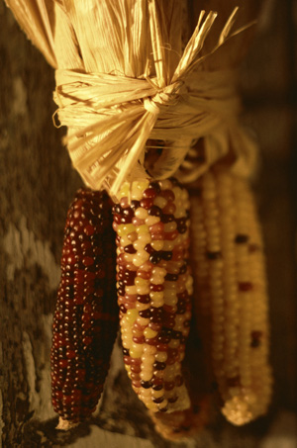
The History of
Mendelian Genetics
Mendel’s work was published in 1866, just seven years after Darwin’s theory of the Origin of Species by Natural Selection.
At first his work was overlooked, which was unfortunate for Darwin who was looking for a mechanism by which natural selection could operate.
Mendel’s work was rediscovered in 1900 (after his death) by three scientists, working independently on similar plant breeding experiments:
  Hugo DeVries (peas and maize)
  Erich von Tschermak (peas)
  Carl Correns (garden stock and maize)
Correns work on the genetics of maize showed that factors other than simple dominance could be important in the inheritance of certain traits.

Slide 20
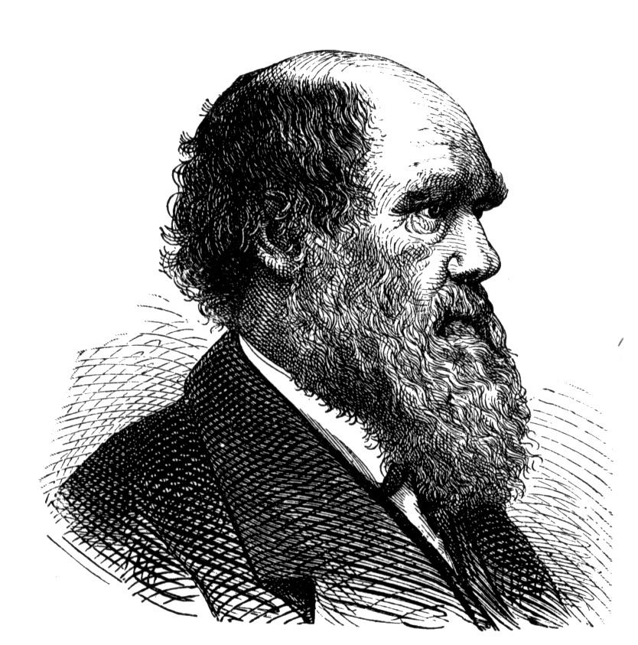
The History of
Mendelian Genetics
The later marriage between Mendel’s laws of inheritance and Darwin’s theory of natural selection is called NEODARWINISM.
Evolution
+
Genetics

Slide 21



Dominance & Recessiveness
Parent plants
Without knowledge of chromosomes or nuclear division, Mendel formulated a number of laws to describe the inheritance of traits in pea plants.
His law of particulate inheritance, states that:
Each gene is controlled by two ‘factors’
  With our present knowledge, we now state this idea as each gene having two alleles.
  Factors do not blend, but may be either dominant or recessive.
  Recessive factors (alleles) are masked by dominant ones.
  Recessive factors (e.g. white flowers) may ‘disappear’ in one generation, and reappear in the next.
X
White
Purple
Generation 1
X
The offspring are inbred (self-pollinated)
Generation 2

Slide 22
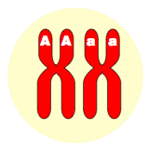
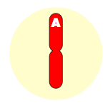
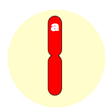
Mendel’s Law of Segregation
Each pair of alleles is sorted into different gametes and subsequently into different offspring. This is the result of the way each allele is carried on separate homologous chromosomes that are separated during meiosis.
  For any particular gene, an individual may be homozygous (i.e. AA or aa), heterozygous (i.e. Aa).
  Gametes contain only one copy of a gene since they only receive one chromosome from each homologous pair.
Homologous pair of chromosomes, each has a copy of the gene on it (A or a)
Oocyte
Meiosis
Gametes

Slide 23
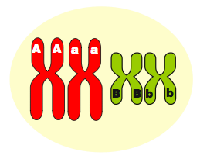
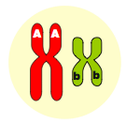
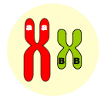
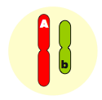
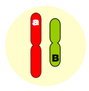
Law of Independent Assortment
Oocyte
Alleles for different traits are sorted independently of each other.
All combinations of alleles are distributed to gametes with equal probability.
During meiosis, alleles on one pair of homologous chromosomes separate independently from allele pairs on other chromosomes.
These alleles will be inherited in
the offspring in predictable
ratios determined by the
genotype of the parents.
Genotype: AaBb
Intermediate
Cells
Gametes
Ab
Ab
aB
aB

Slide 24
Independent Assortment 1
In an example where the inheritance of just two genes carried on separate chromosomes is studied, one possible result of the sorting of the genes is:
Oocyte
Intermediate
cell
Intermediate
cell
Genotype: AaBb
In the four gametes produced, the two possible genotypes are Ab and aB.
Gametes
Ab
Ab
aB
aB

Slide 25
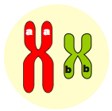
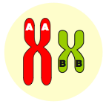
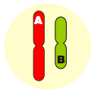
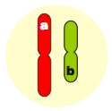
Independent Assortment 2
In the same study of the inheritance of two genes on separate chromosomes, another possible combination of genes can result from the sorting process:
Oocyte
Intermediate
cell
Genotype: AaBb
Intermediate
cell
In the four gametes produced, the two possible genotypes are AB and ab.
Gametes
AB
AB
ab
ab

Slide 26
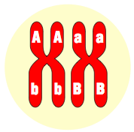
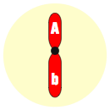
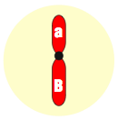
Linked Genes
Genes on the same chromosome are said to be linked. They are inherited together as a unit and do not undergo independent assortment.
Linkage can alter expected genotype and phenotype ratios in the offspring.
  In this example, only two types of gamete are produced instead of
  the expected four kinds if the genes
  were assorted independently.
One homologous pair of chromosomes
Oocyte
Meiosis
Gametes
Ab
Ab
aB
aB
Genes A and B control different traits and are on the same chromosome

Slide 27
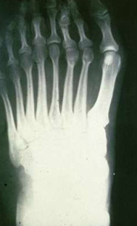
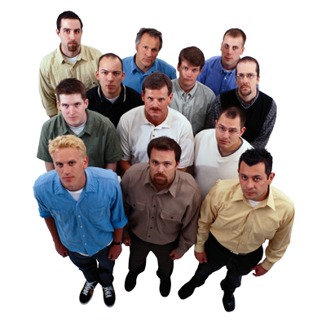





Selected Hereditary Traits
Dominant | Recessive
Right handedness | Left handedness
Hair on middle | Segment of digits no hair
Hitch-hiker’s thumb | Normal thumb
Polydactylism (extra digits) | Normal digits
Brachydactylism (short digits) | Normal digits
Pattern baldness | Normal hair
Free ear lobes | Attached ear lobes
Polydactylism is a dominant trait; a normal number of digits is the recessive condition.
Free ear lobe
Attached ear lobe
Hitch-hiker’s thumb
In this crowd of men, almost all show some degree of pattern baldness, a dominant trait.
Mid-digit hair
Handedness

Slide 28


Eye Color
Determination of eye color is complex, involving perhaps many genes.
  Any eye color other than pure blue is determined by a dominant allele
  that codes for the production of the pigment called melanin.
  Hazel, green, grey and brown eyes are dominant over blue.
Dominant
Recessive
Phenotype: | Brown, green, hazel, or grey
Allele: | B
Phenotype: | Blue
Allele: | b

Slide 29


Human Handedness
The trait of left or right handedness is genetically determined.
  Right-handed people have the dominant allele.
  People that consider themselves ambidextrous can assume they have the dominant allele for this trait.
Dominant
Recessive
Phenotype: | Right-handed
Allele: | R
Phenotype: | Left-handed
Allele: | r

Slide 30


Human Tongue Roll
The ability to roll the tongue into a U-shape when viewed from the front is controlled by a dominant allele.
  There are rare instances where a person can roll it in the opposite direction (to form an n-shape).
Dominant
Recessive
Phenotype: | Can roll tongue
Allele: | T
Phenotype: | Cannot roll tongue
Allele: | t

Slide 31


Human Mid-Digit Hair
Some people have a dominant allele that causes hair to grow on the middle segment of their fingers.
  It may not be present on all fingers, and in some cases may be very fine and hard to see.
Dominant
Recessive
Phenotype: | Hair on mid segment
Allele: | M
Phenotype: | No hair on mid segment
Allele: | m

Slide 32


Thumb Hyperextension
There is a gene that controls the trait known as hitchhiker's thumb, which is technically termed distal hyperextensibility.
People with the dominant phenotype are able to curve their thumb backwards without assistance, so that it forms an arc shape.
Dominant
Recessive
Phenotype:
Hitchhikers thumb
Phenotype:
Normal thumb
Allele:
H
Allele:
h

Slide 33


Human Ear Lobe Attachment
In people with only the recessive allele (homozygous recessive), ear lobes are attached to the side of the face.
The presence of a dominant allele causes the ear lobe to hang freely.
Dominant
Recessive
Phenotype: | Lobes free
Allele: | F
Phenotype: | Lobes attached
Allele: | f

Slide 34


Other Hereditary Traits
Dominant | Recessive
Curly hair | Straight hair
Dark brown hair | All other colors
Coarse body hair | Fine body hair
Syndactylism (webbed digits) | Normal digits
Normal skin pigmentation | Albinism
Brown eyes | Blue or grey eyes
Near or far-sightedness | Normal vision
Normal hearing | Deafness
Normal color vision | Color blindness
Broad lips | Thin lips
Large eyes | Small eyes
Roll tongue into U-shape | No tongue roll
A or B blood factor | O blood factor
Brown eyes are dominant over blue
Dark brown hair is dominant over other hair colors

Slide 35








Genomic Imprinting
The phenotypic effects of some mammalian genes depend on whether they were inherited from the mother or the father.
This phenomenon, called genomic imprinting, is part of epigenetics, which looks at the heritable changes in gene function that occur without involving nuclear DNA.
  Just as cells inherit genes, they also inherit instructions that tell the genes when to become active, in which tissue, and to what extent.
  Epigenetic phenomena are important because they regulate when and at what level genes are expressed.
Maternal imprint on chromosome in egg
Paternal imprint on chromosome in sperm
Inherited imprinting affects the development of the individual
Somatic cells
Maternal and paternal chromosomes are differently imprinted. Each generation, chromosomes are newly imprinted.

Slide 36



Imprinted Genes
How are imprinted genes different?
  In some cases, an imprinted gene is activated only if it is inherited from the father; in other cases, only if it comes from the mother. The corresponding allele is inactivated.
  Evidence of this is seen in two human genetic disorders. Both are caused by the same mutation: a specific deletion of chromosome 15.
    If the mutation is inherited from the father, the result is Prader-Willi syndrome.
    If the mutation is inherited from the mother, the result is Angelman syndrome.
Paternal chromosome
Maternal chromosome
Deletion mutation
Prader-Willi syndrome
Angelman syndrome
Mental retardation, obesity, short stature, unusually small hands and feet
Uncontrollable laughter, jerky movements, motor and mental abnormalities

Slide 37

Gene Silencing
How are genes imprinted? Imprints may act as silencers or activators for imprinted genes.
  DNA methylation is a well understood example of an imprinting phenomenon.
  DNA methylation turns off gene expression by establishing a silent chromatin state through the addition of a methyl-group to cytosines in the DNA.
  This changes the state of the chromatin so that the expression of any genes in the methylated region is inhibited.
  In this way, either a maternal or paternal gene may be silenced.
  Methylation is also important in the X-inactivation of chromosomes.
Which genes did you inherit from your mother and which from your father? For some genes, imprinting will affect phenotypic expression.

Slide 38


Genotype and Phenotype
Genotype
Phenotype
The genotype of an organism refers to its genetic make-up.
The phenotype of an organism refers to its observable features or traits.
  There can be more than one genotype for a given phenotype because a recessive allele will not be expressed if a dominant allele is present that masks its effect.
  By convention, dominant alleles are labeled with a capital letter and recessive ones with a lower case letter.
  A heterozygote will be a carrier for a recessive allele. Carriers may be unaware that they carry a recessive allele until they have children.
PP
(homozygous)
Purple
Pp
(heterozygous)
Purple
Pp
(heterozygous)
Purple
pp
(homozygous)
White
Grouping the second generation offspring from a monohybrid cross for flower color reveals two phenotypes, but three genotypes

Slide 39
Genetic Crosses
In genetic crosses, the offspring are referred to by how many generations removed they are from the parental (P) generation:
  F1 = the heterozygous offspring of a cross between two true breeding parents.
  F2 = offspring of a cross between two F1 offspring.
Mating
P
X
Female parent
Male parent
F1
F2
F1 mated together produced these offspring

Slide 40


Hybrids
Organisms that are true-breeding for a particular trait will always produce offspring with the same phenotype; they are homozygous for that trait.
Hybrids are the progeny resulting from a cross (mating) between two genetically different individuals.
  Hybrids maybe identical to the parents in some traits but not all.
  Hybrids recombine traits of (often inbred) parental lines and show increased heterozygosity.
  This is associated with greater growth survival, and fertility in the offspring; a phenomenon known as hybrid vigor.
Maize breeding program, Texas A&M University
Inbred A
Hybrid
Inbred B
Modern wheat is an example of a crop that has gained its current properties through hybrid vigor

Slide 41




Genetic Crosses 1
Although all the physical characteristics of an organism are inherited, sometimes breeders choose to select for characters or traits that are of interest to them.
Depending on the number of traits involved
(one, two, three) these crosses are:
  Monohybrid cross
    One trait studied, e.g. coat color
  Dihybrid cross
    Two traits studied, e.g. coat color
    and coat length
  Trihybrid cross
    Three traits studied, e.g. coat
    color, length, and curliness.

Slide 42

Genetic Crosses 2
Crosses can be shown by separating the parental alleles (or allele combinations) and recombining them in the offspring:
  Monohybrid cross: The inheritance
  of one gene (A) is studied.
  Dihybrid cross: The inheritance of
  two genes (A and B) is studied.
  Trihybrid cross: The inheritance of
  three genes (A , B, and C) is studied.
Parents
Aa
X
Aa
Possible
offspring
AA
Aa
aa
Monohybrid cross
AaBb
Cc
X
AaBb
Cc
Parents
AaBb
X
AaBb
Parents
Possible offspring
AAB
BCC
AaB
BCC
aaB
BCC
AAB
bCC
Possible
offspring
AABB
AABb
AaBB
AaBb
(plus many more)
AAb
bCC
AAB
BCc
AAB
Bcc
AaB
bCc
aaBb
Aabb
AAbb
aaBB
aabb
Trihybrid cross
Dihybrid cross

Slide 43

Selfing
X
Some particular genetic crosses will reveal specific information about the parental lines. These simple breeding tests are designed to reveal the genotype of the parents:
  Examples: selfing, testcross, backcross.
Selfing (self-fertilization) is used only in plant breeding.
  A plant of unknown genotype is fertilized with its own pollen and the phenotypic ratios of the progeny indicate the likely parental genotype.
Selfed
Progeny 3:1 red: white. Parent must be heterozygous
X
Selfed
e.g. red flower x red flower
If parent is Rr: 3:1 ratio of red to white flower
If parent is RR: All offspring will have red flowers
Progeny all red. Parent must be homozygous

Slide 44
Testcross and Backcross
An individual with the dominant phenotype may be homozygous dominant or heterozygous.
The genotype of individuals with the dominant phenotype can be established by carrying out a testcross (right) which the unknown genotype is crossed with a homozygous recessive.
The results of a testcross are definitive in that the unknown genotype will be revealed.
Where an individual is crossed with one of its parents for the same purpose, it is referred to as a backcross.
Dominant phenotype
with unknown genotype
Recessive phenotype
with known genotype
RR
or
Rr
X
rr
If unknown genotype is RR, then all of the offspring should be red
If unknown genotype is Rr,
then 50% of offspring should be red and 50% white
r
r
r
r
R
R
R
r
All Rr
50% Rr, 50% rr

Slide 45
Monohybrid Cross
Homozygous purple
Homozygous white
A monohybrid cross examines the inheritance of one trait, e.g. the inheritance of flower color in peas.
The F1 offspring of a cross between two true breeding parent plants are all purple (Pp).
  Note: F1 notation is only used to denote the heterozygous offspring of true breeding parents.
A cross between these offspring
(Pp x Pp) would yield a 3:1 ratio in the F2 generation:
X
P
PP
pp
P
P
Gametes
p
p
F1
Pp
Pp
Pp
Pp
P
p
Gametes
P
p
F2
3 purple (PP, Pp, Pp); 1 white (pp)
PP
Pp
Pp
pp

Slide 46
Using a Punnett Square
The British geneticist
R. Punnett devised a method of calculating all possible combinations of gametes and offspring using a grid structure, now called the Punnett square.
The Punnett square is now used to represent the outcome of crosses; the gametes from each parent are separated on each axis and recombined in the spaces within the grid.
Parents
X
Pp
Pp
Each parent provides two gametes for the grid
P
p
Gametes
Offspring
P
PP
Pp
Gametes
p
Pp
pp

Slide 47



Monohybrid Cross 1
In this example, the parents have different phenotypes for coat color: black and white.
The two parents are true-
breeding (i.e. homozygous)
for this characteristic:
  Homozygous black is
  true-breeding for black.
  Homozygous white is
  true breeding for white.
The offspring will all be
the black phenotype.
The offspring will all be
heterozygous and carriers
for the recessive white allele.
Homozygous white
Homozygous black
bb
BB
X
P
Possible fertilizations
Gametes
b
b
B
B
Bb
Bb
Bb
Bb
F1
Heterozygous black
The F1 refers to the heterozygous offspring of true-breeding parents

Slide 48
Monohybrid Cross 2
Here, the parents have the same black phenotype for coat color.
Both parents are
true-breeding
(i.e. homozygous)
for this characteristic.
The offspring will all be
the black phenotype.
  The offspring will all be
  the same phenotype and
  genotype as the parents:
  black homozygotes
Homozygous black
Homozygous black
BB
X
BB
P
B
Possible fertilizations
B
Gametes
B
B
BB
BB
BB
BB
Homozygous black offspring

Slide 49

Monohybrid Cross 3
Here, the parents have the same white phenotype for coat color.
Both parents are
true-breeding
(i.e. homozygous)
for this characteristic.
The offspring will all be
the white phenotype.
  The offspring will all be
  the same phenotype and
  genotype as the parents:
  white homozygotes
Homozygous white
Homozygous white
bb
X
bb
P
Possible fertilizations
Gametes
b
b
b
b
bb
bb
bb
bb
Homozygous white offspring

Slide 50
Monohybrid Cross 4
In this cross, the parents have different phenotypes for coat color:
black and white.
  One is true-breeding
  (homozygous)for white.
  One is heterozygous for
  the black coat color.
Half of the offspring will be
black and half will be white.
The black offspring will be
heterozygous and
carry the recessive
white allele.
Homozygous white
Heterozygous black
bb
X
Bb
P
Possible fertilizations
Gametes
b
b
B
b
Bb
bb
Bb
bb
Half homozygous white offspring and half heterozygous black

Slide 51
Monohybrid Cross 5
Here, the parents have the same black phenotype for coat color.
  One is heterozygous for
  the black coat color and
  a carrier for the recessive
  white allele.
  One is true-breeding
  (homozygous) for black.
The offspring will all be
the same black phenotype.
Homozygous and
heterozygous
genotypes will be
produced in a 1:1 ratio.
Heterozygous black
Homozygous black
Bb
X
BB
P
Possible fertilizations
Gametes
B
b
B
B
BB
BB
Bb
Bb
All offspring are black, with homozygotes and heterozygotes in equal proportions

Slide 52
Monohybrid Cross 6
Here, the parents have the same black phenotype for coat color.
  Both are heterozygous for
  black coat color and carry
  the recessive white allele.
The offspring will be
produced in the
phenotypic ratio:
3 black and 1 white.
The genotype ratios will be:
Heterozygous black
Heterozygous black
Bb
X
Bb
P
Possible fertilizations
Gametes
B
b
B
b
1 BB : 2 Bb : 1 bb
BB
Bb
Bb
bb
3 : 1 phenotypic ratio
1 : 2 : 2 genotypic ratio

Slide 53




Dihybrid Crosses
Inflated, yellow pod
constricted, green pod
A dihybrid cross involves the inheritance patterns of two traits.
Simple dihybrid crosses assume that the genes described are carried on separate chromosomes and assort independently during meiosis (there is no linkage).
Parents
P
IIgg
X
iiGG
First filial
F1
IiGg
X
IiGg
inflated, green pod
Second filial:
F2
IIGG
IiGG
IiGg
IIGg
Contains a dominant allele
for each of the 2 genes
– will show dominant
phenotype for each gene
Inflated, green pod
Inflated, yellow pod
IIgg
Iigg
Contains a dominant
allele for only gene A
constricted, green pod
iiGG
iiGg
Contains a dominant
allele for only gene B
constricted, yellow pod
Contains only
recessive alleles
iigg
Genotypes are grouped into offspring with the same phenotype

Slide 54





Dihybrid Cross Explained
Homozygous yellow-round
Homozygous green-wrinkled
Parents
X
Gametes
YR
yr
F1
All yellow-round
YyRr
X
YyRr
Offspring F2
Female gametes
Yellow-round
Possible
fertilizations
YR
Yr
yR
yr
Green-round
YR
Yellow-wrinkled
Yr
Green-wrinkled
Male Gametes
yR
yr

Slide 55

Dihybrid Cross 1
In the example below, the characters involved are coat color and coat length in guinea pigs. The alleles for short hair and black color are dominant.
The parental types are homozygous and produce only one type of gamete for each trait.
The F1 offspring are all heterozygotes.
Homozygous black, short
Homozygous white, long
BBLL
X
bbll
P
BL
Possible fertilizations
bl
Gametes
Only one type of gamete is produced from each parent
BbLl
X
BbLl
As there is only one kind of gamete from each parent, there is only one kind of offspring produced in the first generation: heterozygous black, short hair.

Slide 56

Dihybrid Cross 2
If the F1 heterozygotes from the previous example are crossed with each other four kinds of gamete are produced: BL, BI, bL, bl
A Punnett square displays the expected ratio of the offspring genotypes and phenotypes. The offspring are produced in an expected 9 : 3 : 3 : 1 ratio.
Female gametes
BL
Bl
bL
bl
Possible
fertilizations
Offspring (F2)
BL
Each of the 16 animals shown here represents the possible zygotes formed by different combinations of gametes coming together at fertilization.
BBLL
BBLl
BbLL
BbLl
Bl
BBLl
BBll
BbLl
Bbll
Male gametes
bL
BbLl
BbLl
bbLL
bbLl
bl
BbLl
Bbll
bbLl
bbll

Slide 57
Dihybrid Cross 3
The offspring F2 will be produced in a 9:3:3:1 phenotype ratio:
Genotype
Phenotype
The offspring are arranged in phenotypic groups
1 BBLL
2 BbLL
2 BBLl
4 BbLl
9 black and short hair
A total of 9 offspring with one of four different genotypes can produce black, short hair
9 black, short
3 black and long hair
1 BBll
2 Bbll
A total of 3 offspring with one of two different genotypes can produce black, long hair
3 black, long
3 white and short hair
1 bbLL
2 bbLl
A total of 3 offspring with one of two different genotypes can produce white, short hair
3 white, short
1 white and long hair
1 bbll
Only 1 offspring of a given genotype can produce white, long hair
1 white, long

Slide 58


Dihybrid Cross Exercise
Homozygous white, short hair
Heterozygous black, homozygous long hair
bbLL
Bbll
For these two guinea pig parents, determine:
  all possible gametes produced by each parent for the genes of interest.
  all possible genotypes and phenotypes in the offspring.
Parents
Gametes
bL
bL
bL
bL
Bl
Bl
bl
bl
One kind of gamete
Two kinds of gametes
Offspring
Female gametes
Possible
fertilizations
Bl
Bl
bl
bl
bL
BbLl
BbLl
bbLl
bbLl
Parental gametes
White parent gametes: bL
Black parent gametes: Bl, bL
Offspring
50% black short (BbLl)
50% white short (bbLl)
bL
BbLl
BbLl
bbLl
bbLl
Male gametes
bL
BbLl
BbLl
bbLl
bbLl
bL
BbLl
BbLl
bbLl
bbLl

Slide 59



Crossing Over 1
Higher organisms such as plants and animals reproduce through sexual reproduction.
Offspring possess a combination of characteristics from maternal and paternal chromosomes.
The maternal and paternal chromosomes pair at meiosis and genetic material is exchanged between them by a process called crossing over.
Crossing over can only occur when homologous chromosomes synapse (come together side-by-side) during the early stages of meiosis:
Maternal chromosome
Centromere
Chromatids
Chromatids
Paternal chromosome
Genes
Y
X

Slide 60



Crossing Over 2
During this period of close association, it is possible for chromatids with corresponding gene sequences to become entangled to form chiasma.
‘Equivalent’ segments of homologous chromosomes are able to be exchanged at these points.
Each of the two homologous chromosomes has exchanged genes between neighboring chromatids, leaving the outer chromatids untouched.
Each chromosome will pass into the intermediate cells of meiosis to enter the second division of meiosis.
Chiasma in the process of forming
Chromatid of maternal origin
Crossing over point
Mixed types
Chromatid of paternal origin

Slide 61




Crossing Over 3
During the final division of meiosis, the chromatids that were bound together are separated.
Each of the four chromatids, with any recombined genes, will end up in one of the four gametes.
If some chromatids were not involved in crossing over, some of the gametes will have ‘parental’ allele sequences.
Chromatid of maternal origin
Chromatids of mixed maternal and paternal origin
Chromatid of paternal origin
Each of these four chromosomes will end up in a separate gamete:
Gametes

Slide 62







Linked Genes 1
Genes located on the same chromosome are said to be linked (e.g. genes A and B).
Linked genes tend to be inherited together.
Linkage results in fewer genetic combinations of alleles in offspring (compared to genes on separate chromosomes).
In describing linkage, the appropriate notation shows a horizontal line separating linkage groups.
Parent 1 (2N)
Parent 2 (2N)
Linked
AB
ab
ab
ab
Linked
Two genes are linked when they are on the same chromosome
Line indicates linkage
Chromosome pair before replication
Chromosomes after replication

Slide 63




Linked Genes 2
The inheritance patterns involving linked genes do not follow expected Mendelian ratios.
In this example of linked genes, only two kinds of genotype combinations occur in the offspring.
Without linkage, the same parents would provide four possible genotypes: AaBb, Aabb, aaBb, aabb.
Chromosomes after replication
X
Meiosis
Gametes (N)
Only one gamete from each replicated chromosome is shown
Possible offspring
Only two genotype combinations occur
AaBb
AaBb
aabb
aabb

Slide 64




Linked Genes in Drosophila 1
The genes for wing shape (straight or curled) and body color (grey or ebony) are on the same chromosome and are inherited together:
Inheritance of linked genes in Drosophila
The genes for wing shape and body color are linked(they are on the same chromosome).
Parent
Wild type female
Mutant male
Phenotype
Straight wing
Gray body
Curled wing
Ebony body
Genotype
Cucu Ebeb
cucu ebeb
Linkage notation
Cu Eb
cu eb
cu eb
cu eb

Slide 65


Linked Genes in Drosophila 2
The inheritance of these linked genes in Drosophila produces a greater proportion of parental types than would be expected if the genes were on separate chromosomes (assorting independently).
X
Wild type female
Mutant male
Straight wing
Gray body
Curled wing
Ebony body
Cucu Ebeb
cucu ebeb
Meiosis
Gametes from female fly (N)
Gametes from male fly (N)
CuEb
cueb
cueb
cueb
CucuEbeb
CucuEbeb
cucuebeb
cucuebeb
Sex of offspring is irrelevant in this case

Slide 66


Recombination 1
Recombination refers to the exchange of alleles between homologous chromosomes as a result of crossing over between linked genes.
Recombination results in new combinations of parental characteristics in the offspring.
These offspring are called recombinants.
Recombination between alleles
of parental linkage groups is
indicated by the appearance of recombinants in the offspring,
although not in the proportions
that would be expected with
independent assortment.
Parent 1 (2N)
Parent 2 (2N)
AB
ab
ab
ab
Before replication
Linked genes
After replication
X
Crossing over has occurred
Meiosis
AB
Ab
aB
ab
ab
ab
ab
ab
Gametes (N)
Offspring
AaBb
aabb
Aabb
aaBb
Non-recombinant offspring
Recombinant offspring

Slide 67
Recombination in Drosophila
This example describes the inheritance of linked alleles in Drosophila where crossing over occurs between the alleles in a linkage group in the female parent.
The genes involved are for wing shape and body color.
Wild type female
Mutant male
Straight wing
Gray body
Curled wing
Ebony body
Cucu Ebeb
cucu ebeb
Meiosis
Gametes from female fly (N)
Gametes from male fly (N)
CuEb
Cueb
cuEb
cueb
cueb
Cucu Ebeb
cucu ebeb
Cucu ebeb
cucu Ebeb
Straight wing
Gray body
Curled wing
Ebony body
Straight wing
Ebony body
Curled wing
Gray body
Non-recombinant offspring
Recombinant offspring
The sex of the offspring is irrelevant in this case

Slide 68
Crossover Frequencies
Parent 1
Parent 2
The proportion of recombinants in the offspring can be used to calculate the frequency of recombination (also called the crossover value or COV).
AaBb
aabb
X
The progeny from these
parents have the following
phenotype frequencies:
AaBb 108 Parental
aabb 97 Parental
Aabb 33 Recombinant
aaBb 42 Recombinant
Total 280
These two phenotypes can only occur if crossing over allows new allele
combinations to occur
CALCULATION
The amount of recombination between the genes A and B is:
No. of recombinant types
X 100 = % crossing over
Total no. of offspring
33 + 42
X 100 = 26.8% between genes A and B
280

Slide 69


Chromosome Mapping
Generally, the further apart any two genes are on the same chromosome, the greater the incidence of crossing over between them.
By determining crossover frequencies between two genes, their sequence and genetic distance on a chromosome can be established.
A
26.8%
B
By providing cross over frequencies for other combinations of genes, it is possible to create a chromosome map.
A map for the following cross over frequencies:
Calculation:
Using the crossover frequency (COV) between the two genes, the relative position of genes A and B can be represented on a genetic map:
A – C = 10%, A – B = 22%, B – C = 12%
10 map units
12 map units
22 map units

Slide 70


Allele Expression
Crosses between pure breeding individuals that differ in one or two pairs of genes do not always produce progeny in the expected Mendelian ratios.
This may be because:
  The genes are linked or sex-linked.
  Allele expression not always as simple as dominant alleles overriding recessive ones.
Alleles of a single gene may interact together and give rise to phenotypes that are dissimilar to both of the parents.
Types of allele expression include:
  Incomplete dominance
  Codominance and multiple alleles
  Lethal alleles
Incomplete dominance in snapdragons produces pink flowers from red and white parents
Roan coat color in cattle is a result of codominance between red and white alleles

Slide 71
Lethal Alleles
Lethal alleles are gene mutations that result in a gene product which is not only non-functional, but affects organism survival. Some lethal alleles are fully dominant and are therefore lethal in the heterozygote. Dominant lethal alleles are usually eliminated rapidly, because their expression is fatal.
  Exceptions occur when the expression of the allele is delayed until after reproductive maturity, as occurs in Huntington disease.
In other cases (e.g. Manx cats), the allele
mutation results in a viable heterozygote
with a recognizable phenotype.
Recessive lethal alleles are fatal only in
the homozygote since their effect is
masked in the heterozygote carrier.

Slide 72



Examples of Lethal Alleles
When lethal genes prevent full term development of the embryo, offspring are produced in a 2:1 ratio (2 heterozygotes to one normal).
In the inheritance of coat color in yellow mice, offspring phenotype ratios depart from the expected Mendelian 3:1 when yellow mice are mated together.
  About two thirds of the offspring are yellow, and one third are non-yellow (right). A testcross reveals the yellow colored mice to be heterozygotes.
Parents
Yy
Yy
X
Gametes
Y
y
Y
y
Possible
fertilizations
YY
Yr
Yr
yy
Not viable
Offspring

Slide 73


Incidence of Lethal Alleles
The average human is heterozygous for 3 to 5 lethal recessive genes.
Example: brachydactyly in humans
  Shortening of the finger bones is caused by a lethal allele; heterozygotes have shorter fingers, but homozygotes for the lethal allele die in infancy from other skeletal defects.
  Of the offspring of two brachydactylic people, one in four will die in infancy, one half will show brachydactyly, and one in four will be normal (1:2:1 ratio).
X-ray of a normal hand
Brachydactyly: note the shortened bones

Slide 74





The Manx Mutation
Cats produce a gene controlling spine length and therefore production of a tail.
The allele for taillessness (M^{L}) is incompletely dominant over the allele for a normal tail (M).
  The Manx allele M^{L} interferes with spinal development and heterozygotes (M^{L} M) have no tail (the Manx phenotype).
  In M^{L} M^{L} homozygotes, the double dose of the allele produces an abnormal embryo, which does not survive.
Parents
MM^{L}
MM^{L}
X
Gametes
M
M^{L}
M
M^{L}
Possible
fertilizations
MM
MM^{L}
MM^{L}
M^{L}M^{L}
Normal
Manx
Manx
Not viable
Offspring

Slide 75






Incomplete Dominance
In cases of incomplete dominance, neither allele dominates and the heterozygote is intermediate in phenotype between the two homozygotes.
In crosses involving incomplete dominance, the genotype and phenotype ratios are identical.
  Examples of incomplete dominance include flower color in snapdragons (right) and sweet peas, where red and white flowered plants cross to produce pink flowered plants.
C^{w}C^{w}
C^{R}C^{w}
C^{R}C^{R}

Slide 76
Flower Color in Snapdragons
Flower color in snapdragons exhibits incomplete dominance, with red flowered and white flowered plants crossing to produce offspring with pink flowers.
Red flower
White flower
Parents
C^{R}C^{R}
X
C^{W}C^{W}
Gametes
C^{R}
C^{R}
C^{W}
C^{W}
Possible
fertilizations
F1 offspring
C^{R}C^{W}
C^{R}C^{W}
C^{R}C^{W}
C^{R}C^{W}
Pink
Pink
Pink
Pink

Slide 77



Snapdragon Backcross
Determine the phenotype and genotype ratios of the offspring resulting from a backcross of the F1 heterozygote to the red parent.
  50% of the offspring are red (RR) and 50% are pink (Rr).
Pink flower
Red flower
Parents
C^{R}C^{w}
C^{R}C^{R}
X
Gametes
C^{R}
C^{w}
C^{R}
C^{R}
Possible
fertilizations
Offspring
C^{R}C^{R}
C^{R}C^{R}
C^{R}C^{w}
C^{R}C^{w}
Red
Red
Pink
Pink

Slide 78




Codominance
In cases of codominance, both alleles are independently and equally expressed in the heterozygote. Examples include:
  Roan (stippled red and white) coat color in cattle. A cross between a red bull and a white cow produces all roan offspring.
  ABO human blood groups.
Red bull
White cow
Parents
C^{R}C^{R}
C^{W}C^{W}
X
Gametes
C^{R}
C^{R}
C^{W}
C^{W}
Possible
fertilizations
C^{R}C^{W}
C^{R}C^{W}
C^{R}C^{W}
C^{R}C^{W}
F1 offspring
Roan
Roan
Roan
Roan

Slide 79




Codominance in Cattle
In a cross between two heterozygous (roan) shorthorn cattle, red, roan, and white offspring are produced in a 1:2:1 ratio.
Roan bull
Roan cow
C^{R}C^{W}
C^{R}C^{W}
Parents
X
Gametes
C^{R}
C^{W}
C^{R}
C^{W}
Possible
fertilizations
C^{R}C^{R}
C^{R}C^{W}
C^{R}C^{W}
C^{W}C^{W}
Offspring
Red
Roan
Roan
White

Slide 80
Crosses Involving Codominance
In examples of codominance where a true breeding red or white parent is crossed with a roan parent, the offspring will occur in a 1 : 1 ratio of the parental types (i.e. roan and red, or roan and white)
Red bull
Roan cow
C^{R}C^{R}
C^{R}C^{W}
Parents
X
Gametes
C^{R}
C^{R}
C^{R}
C^{W}
Possible
fertilizations
C^{R}C^{R}
C^{R}C^{W}
C^{R}C^{R}
C^{R}C^{W}
Offspring
Red
Roan
Red
Roan

Slide 81

Crosses Involving Codominance
White bull
Roan cow
Parents
C^{W}C^{W}
C^{R}C^{W}
X
Gametes
C^{W}
C^{W}
C^{R}
C^{W}
Possible
fertilizations
C^{R}C^{W}
C^{W}C^{W}
C^{R}C^{W}
C^{W}C^{W}
Offspring
Roan
White
Roan
White

Slide 82

Multiple Alleles in Blood
The four common blood groups of the human ABO blood group system are determined by three alleles: A, B, and O (also represented in some texts as I^{A}, I^{B}, I^{O} or just i). This is an example of a multiple allele system for a gene.
ABO antigens consist of sugars attached to the red blood cell surface. These sugars provide the individual antigenic properties. The alleles code for enzymes that join these
sugars together.
  Allele O produces a non-functional enzyme
  that is unable to make changes to the basic
  antigen (sugar) molecule.
  The other two alleles (A, B) each produce
  a different enzyme that adds a different,
  specific sugar to the basic antigen.
Any one individual possesses only two
alleles and they are expressed equally.
RBC
RBC

Slide 83





Multiple Alleles in Blood
Phenotype (blood group) | Genotypes | Allele codes for molecule |  | Antigen | Antibodies in serum
O | OO | Precursor | Precursor antigen without extra sugar at end | None (also called universal donor)
A | AA, AO |  | acetyl- galactosamine added to precursor
B | BB, BO |  | galactose added to precursor
AB | AB |  | Contains both sugars |  | None (also called universal recipient)

Slide 84



Multiple Alleles in Blood
Blood donors must be compatible otherwise the red blood cells of the donated blood will clump together (agglutinate) and block capillaries.
Phenotype | Genotypes | Antibodies in serum | Results from adding RBCs from groups below to serum from groups at left
A | AA, AO | anti-B
B | BB, BO | anti-A
AB | AB | none
O | OO | anti-A anti-B
A
B
AB
O

Slide 85


Multiple Alleles in Blood
Blood group: AB
Blood group: AB
EXAMPLE 1:
For both parents with AB blood type, half of the offspring will be the same as the parents (AB), one quarter will be type A and one quarter will be type B.
Parent genotypes
X
AB
AB
Gametes
A
B
A
B
Possible fertilizations
Children's
genotypes
AA
AB
AB
BB
Blood groups
A
AB
AB
B

Slide 86


Multiple Alleles in Blood
EXAMPLE 2:
Two parents with blood groups A and B respectively, may produce offspring with all four possible blood groups: AB, A, B and O.
This may only occur if both parents are carrying the allele for group O.
Blood group: B
Blood group: A
Parent genotypes
X
BO
AO
Gametes
B
O
A
O
Possible fertilizations
Children's' genotypes
AB
BO
AO
OO
Blood groups
AB
B
A
O

Slide 87
Sex Linkage
Sex linkage refers to the phenotypic expression of an allele that is dependent on the sex of the
individual and is directly tied to the sex chromosomes.
Most sex linked genes are present on the X chromosome (X-linkage) and have no corresponding allele on the smaller male chromosome.
In some cases, a phenotypic trait is determined by an allele on the Y chromosome. Because the Y chromosome is small and does not contain many genes, few traits are Y-linked and Y-linked diseases are rare.
X
Y
Note the size differences between the X and Y chromosomes. The Y lacks alleles for many of the genes present on the X.

Slide 88









Sex Linkage
Sex-linked traits show a distinct pattern of inheritance.
  Fathers pass sex-linked alleles to all their daughters but not to their sons.
  Mothers can pass sex-linked alleles to both sons and daughters.
  In females, sex-linked recessive traits will be expressed only in the homozygous condition.
  In contrast, any male receiving the recessive allele from his mother will express the trait.
Unaffected father
Carrier mother
X
Y
X
X
X
Y
X
X
X
X
X
Y
Unaffected son
Unaffected daughter
Carrier daughter
Affected son

Slide 89


Sex Linked Recessive Inheritance
For a recessive trait controlled by a gene on the X chromosome, the features of inheritance can be illustrated with the standard symbols used on pedigree charts. Note that:
  More males than females express the trait.
  Carrier females do not show the trait but pass it to sons.
  All daughters of affected males will at least be carriers of the trait.
Unaffected female
Affected male
Carrier
Famously, Queen Victoria was a carrier of the allele for hemophilia, passing it to one of her sons and, through her daughters, to the royal families of Prussia, Russia, and Spain.

Slide 90


X Inactivation
In the nucleus of any non-dividing somatic cell, one of the X chromosomes condenses to form a visible piece of chromatin, called a Barr body.
  The chromosome in inactivated,
  so that only one X chromosome
  in a cell ever has its genes expressed.
  The inactivation is random. In
  any cell, the inactive X may be
  either the maternal homologue
  or the paternal homologue.
    Random X inactivation is
    responsible for the tortiseshell
    and calico coloring in domestic cats.
  The presence of Barr bodies is
  important in viable human aneuploidies.
B = dominant allele (black fur)
Y = recessive allele (yellow fur)
X^{B}
X^{Y}
=
inactive alleles
on Barr bodies
X^{B}
X^{Y}
X^{B}
X^{Y}

Slide 91


Sex Linked Dominant Inheritance
Sex-linked dominant inheritance is rarer because all daughters of affected males will be affected (the heterozygous condition is not a carrier).
Sex-linked dominant traits are never passed from father to son.
Affected females produce 50% normal and 50% affected offspring.
Unaffected female
Affected male
Some X-linked dominant conditions, such as Aicardi syndrome, are lethal to boys. They are usually seen only in girls but may be seen in males with Klinefelter syndrome (XXY)

Slide 92
Autosomal & Sex-Linked Genes
Autosomal Genes
1. All individuals carry two
alleles of each gene
2. Dominance operates in
both males and females
3. Reciprocal crosses
produce the same results
4. Alleles passed equally to
male and female offspring
Sex-Linked Genes
1. Males carry only one allele
of each gene (hemizygous)
2. Dominance operates in
females only.
3. Reciprocal crosses produce
different results.
4. ‘Criss-cross’ inheritance
pattern: father to daughter to
grandson, etc
Genes on one or other of the sex chromosomes produce inheritance patterns different from that shown by autosomes:
Reciprocal Cross
A reciprocal cross involves a pair of crosses in which the phenotypes of the partners are reversed:
X
Reciprocal
cross
X
Colorblind
female
Normal
male
Normal
female
Colorblind
male
Different results from the two crosses indicate that sex-linkage of the gene is controlling the trait

Slide 93



Sex Linkage in Cats 1
The orange color of cats (red) is caused by the O gene, which changes black pigment into a reddish pigment.
The O gene is carried on the X chromosome. The recessive allele, o, codes for non-red (black).
A tortoiseshell phenotype occurs when both alleles occur together.
  This can only occur in
  female cats because
  two X-chromosomes have
  to be present to carry the
  black and orange alleles.
Allele Types:
  Xo = Black pigment
  XO = Orange pigment
Genotypes and phenotypes
XOXO, XOY
Orange coated female, male
XoXo, XoY
Black coated female, male
XOXo
Tortoiseshell coat (inter-mingled black and orange in fur) in female cats only

Slide 94



Sex Linkage in Cats 2
For the parent cats depicted here, the following can be determined from their mating:
  Parental genotypes
  Possible gametes
  Genotypes and phenotypes of their possible offspring (including their sex).
Tortoiseshell
female
Parent cats
Orange
male
X
XOXo
XOY
XO
Xo
Gametes
XO
Y
Possible fertilizations
Kittens
XOXO
XOY
XoXO
XoY
Orange
female
Orange
male
Tortoiseshell
female
Black
male

Slide 95
Sex Linkage in Cats
EXERCISE:
By knowing the coat color of parent cats the coat colors of the offspring can be determined.
  For the parent cats depicted here, determine:
    Their genotypes
    Possible gametes
    Genotypes and phenotypes of their possible offspring
Blackfemale
Parent cats
Orange
male
X
XoXo
XOY
Xo
Xo
Gametes
XO
Y
Possible fertilizations
XoXO
XoY
XoXO
XoY
Kittens
Male kittens
Genotypes | Phenotypes
XoY | Black
Female kittens
Genotypes | Phenotypes
XoXO | Tortoiseshell

Slide 96



Inherited Traits in Cats
Polydactyly
Coat colors and other inherited features are interesting because they exhibit common genetic phenomena:
  Dominance
    The polydactylism gene with the dominant allele (Pd) produces paws with extra digits.
  Recessiveness
    The dilution gene with the recessive allele (d) dilutes black to grey, and orange to cream.
  Complementary Genes
    The dominant agouti gene (A) must be present for the tabby gene (T) to be expressed.
Dilution
Tabby expression

Slide 97

Inherited Traits in Cats
Coat color genes:
  Multiple alleles
    The albino series (C) produces a range of phenotypes from full color intensity to true albino.
  Incomplete dominance
    The spotting gene (S) has three phenotypes ranging from extensive spotting to no spotting at all (top).
  Lethal alleles
    The manx gene, (M^{L}) produces a stubby or no tail (lower right) in the heterozygote, while the homozygote (M^{L} M^{L}’) condition is lethal, and (MM) is normal.
Grey spotting
Manx

Slide 98


Inherited Traits in Cats
Coat color genes:
Pleiotropy
  The white gene (W) removes pigment from the coat and can cause congenital deafness.
Sex linkage
  The orange coat color gene is X-linked and can convert black pigment to orange.
  Since female cats have two X chromosomes they have three possible phenotypes: black, orange and tortoiseshell
  Males can normally only exhibit two phenotypes: (black and orange).
White cats usually have blue or orange eyes. Those with blue eyes are often deaf. Odd eyed cats (one blue, one orange) are deaf on the blue-eyed side.

Slide 99

Inherited Traits in Cats
Random gene inactivation
  Patchwork coloring in tortoiseshell cats is caused by the random switching off of one or other of the X chromosomes in the female during embryonic development. The colors are expressed in patches.
Environmental effects
  The dark color pointing in siamese and burmese cats where the gene (cs) is only active in the cooler extremities such as the paws, tail and face.

Slide 100





Coat Color Variation in Cats
Blotched tabby (tb)
Broad irregular bands in whorls. Lacks stripes
Wild type (A_B_T_)
Mackerel (striped) tabby with even, well defined, black vertical stripes. The background color is agouti.
Calico
Similar to tortoiseshell but with white fur as well as black and orange
Marmalade (XOXO)
The orange color is expressed, along with the tabby pattern.
Sex-linked orange (XOXO)
Orange coat with little or no tabby pattern
Tortoiseshell (XOXo)
Sex linked and only in females. Coat is a mixture of orange and black
Non-Agouti (aaB_D_)
The absence of the dominant agouti allele with no pigment dilution produces a jet black cat

Slide 101


Inherited Traits in Cats
Polydactylism (Pd–)
This dominant mutation
increases the number of digits
on the paws from 5 (front),
and 4 (rear) up to 6 and 5
Manx tail (M^{L})
The Manx breed of cat has
little or no tail. This dominant
allele is lethal if it occurs in the
homozygous condition.
Ear fold (Fd–)
Most cats have normal pointed
ears. A dominant mutation exists
where the ear is permanently
folded forwards.

Slide 102

Sex Linkage in Humans
A rare form of rickets in humans is a sex-linked dominant trait. It is determined by a dominant allele of a gene on the X chromosome.
  This condition is not treatable with vitamin D therapy.
A typical inheritance pattern is shown. XR indicates affected by rickets.

Slide 103


Genetic Counseling
Genetic counseling is an analysis of the risk of producing offspring with known gene defects within a family.
People usually consider genetic counseling if they have a family history of a genetic disorder, or if a routine prenatal screening test yields an unexpected result.
Counsellors:
  Identify families at risk and investigate the problem present in the family.
  Interpret information about the disorder.
  Analyze inheritance patterns and risks of recurrence.
  Review available options with the family.
?

Slide 104



Genetic Counseling
Genetic counseling provides information to families who have members with birth defects or genetic disorders, and to families who may be at risk for a variety of inherited conditions.
About half of the cases of childhood deafness are the result of an autosomal recessive disorder. Early identification of the problem allows early appropriate treatment.
Pregnant women often have a prenatal test for chromosomal abnormalities such as Down syndrome (trisomy 21) and abnormalities of development such as neural defects.

Slide 105

Identifying Defective Genes
Increasingly, there are DNA tests for the identification of specific defective genes.
While screening for many genetic disorders is now recommended, the use of pre-symptomatic tests for adult-onset disorders, such as Alzheimer's, is still controversial.
Genetic testing may involve:
  Biochemical tests for gene products such as enzymes and other proteins.
  Microscopic examination of stained or fluorescent chromosomes.
  Examination of the DNA itself.
Test | Explanation
Carrier screening | Identifying unaffected individuals who carry one copy of a gene for a disease that requires two copies for expression of the disease.
Preimplantation genetic diagnosis | Screens for genetic flaws in embryos used in in vitro fertilization.
Prenatal diagnosis | Tests for chromosomal abnormalities such as Down syndrome.
Presymptomatic testing | Testing before symptoms appear to determine the risk of developing adult-onset disorders, e.g. Huntington’s disease or cancer.

Slide 106


Genetic Counseling
In the example of the sex-linked dominant form of rickets, the ratios of affected children can be determined if the phenotype and genotype of each parent is known.
  In this case, the prospective parents would be advised that there is a 50% chance of having an affected child. Only girls would be at risk.
Normal
woman
Affected
male
XX
X
XRY
Parents
Gametes
X
X
XR
Y
Possible fertilizations
Children
XXR
XY
XXR
XY
Affected
female
Normal
male
Affected
female
Normalmale

Slide 107


Autosomal Dominant Disorders
These are inherited disorders caused by dominant alleles on autosomes. Dominant conditions are evident both in heterozygotes and in homozygous dominant individuals. Examples include:
  Diabetes insipidus: Inadequate output of anti-diuretic hormone (ADH), leading to the production of large amounts of urine and extreme thirst. Also produced by an X-linked gene.
  Huntington disease: Involuntary movements of the face and limbs with later general mental deterioration. The beginning of symptoms is highly variable, but occurs usually between 30 to 40 years of age.
MRI scans of the brain (top) and blood tests (below) can be used to diagnose Huntington disease.

Slide 108

Autosomal Recessive Disorders
Inherited disorders caused by recessive alleles on autosomes. Recessive conditions are evident only in homozygous recessive genotypes.
Cystic fibrosis: Dysfunction of chloride transport in glands; thick mucus leads to pneumonia and emphysema. Death usually occurs in childhood. CF is the most common lethal genetic disorder in childhood.
Maple syrup urine disease: Mental and physical retardation produced by a block in amino acid metabolism. Isoleucine in the urine produces the characteristic odor.
Tay-Sachs disease: A lipid storage disease causing progressive paralysis, mental deterioration, and blindness. Death usually occurs by three years of age.
(Photo: UK Cystic Fibrosis Gene Therapy Consortium)
The symptoms of cystic fibrosis are treated with inhaled drugs and physical therapy to clear the lungs of mucus. CF has an incidence of about 1 case 3700 live births.

Slide 109








Pedigree Analysis
Pedigree analysis is a way of illustrating inheritance patterns. It is a good way to follow the inheritance of genetic disorders through generations.
Normal female
Affected male
  Symbols are used to represent males, females etc. For traits of interest, symbols can be shaded to indicate individuals carrying the trait.
  Individuals are designated by their generation number and then their order number in that generation.
Sex unknown
Died in infancy
Affected female
Normal male
Non-
identical twins
Identical twins
Carrier (heterozygote)
I, II, III
Generations
1, 2, 3
Children (in birth order)

Slide 110

Pedigree Chart Symbols
In this example, the arrow indicates the propositus or person through which the pedigree was discovered.
Carrier (heterozygote)

Slide 111

Inheritance of Autosomal
Recessive Traits
The pedigree for albinism (lack of pigment in the hair, skin and eyes) is inherited as an autosomal recessive trait.
The trait is not sex linked and is shown by both males and females. The affected female in the third generation has phenotypically normal parents.
  All generation II offspring
  are carriers for the albino
  allele.
  III-2 is an albino girl whose
  paternal grandmother and
  maternal grandfather are
  also albinos.
  All her other relatives are
  phenotypically normal.

Slide 112

Inheritance of X-Linked
Recessive Traits
Hemophilia is an X-linked disorder in which blood clotting time is prolonged.
Women who are heterozygotes are carriers for the recessive allele but do not have hemophilia. They can pass the allele to their sons (XY) who will express the recessive allele and have hemophilia.
  In the first generation, the female
  of the affected family is a carrier
  for the hemophilia allele.
  Two of the offspring of the affected
  family also carry the allele; the male
  is affected and the female is a carrier.
  Offspring of the female carrier and
  an unaffected male can be unaffected,
  carrier females, or affected males.

Slide 113

Inheritance of Autosomal
Dominant Traits
In the inheritance of autosomal dominant traits, each affected individual will have at least one parent who is also affected.
If a large number of families are examined about equal numbers of males and females are affected.
  Inheritance of the rare trait woolly
  hair in humans follows this pattern.
  In the first generation, female I-2
  is heterozygous for the woolly hair
  allele.
  Half of her offspring are also
  heterozygous for the woolly hair
  allele, which t is expressed. The
  the rest (II-5, II-6, II-7) are
  homozygous recessive and
  have normal hair.

Slide 114

Inheritance of X-Linked
Dominant Traits
In this rare pattern of inheritance, all the daughters of affected males will be affected and more females than males will show the trait.
An affected male must always have an affected mother.
  The inheritance of a rare
  form of rickets follows this
  inheritance pattern.
  The male I-2 is affected and all
  his daughters II-2, II-3, and II-4
  are affected.
  The affected female II-4 can
  produce affected offspring of
  both sexes (III-2, III-3).

Slide 115
Sex Determination
In most cases, the determination of the sex of an organism is controlled by the sex chromosomes provided by each parent.
These have evolved to regulate the ratios of males and females produced and preserve the genetic differences between the sexes.
  In humans and other mammals, males are the heterogametic sex because each somatic cell has one X and one Y chromosome (i.e. the two sex chromosomes are different).
  Males are not always the heterogametic sex.In birds and butterflies, the female is the heterogametic sex, and in some insects the male is simply X whereas the female is XX.
Y
X

Slide 116


XY Sex Determination
In the XY type, sex determination is based on the presence or absence of the Y chromosome; without it, an individual will develop into a female.
XY sex determination occurs in:
  Mammals (including humans)
  Fruit fly Drosophila
  Some dioecious (separate
  male and female) plants
  such as kiwifruit.
Females are homogametic with
two similar sex chromosomes
(XX). The male has two unlike
chromosomes (XY) and is
heterogametic.
Primary sex characteristics are
initiated by genes on the X.
‘Maleness’ is determined by the Y.
Female
Male
Parents
XX
X
XY
Gametes
X
X
X
Y
Possible
fertilizations
Offspring
XX
XY
XX
XY
Sex:
Female
Male
Female
Male

Slide 117


WZ Sex Determination
In the WZ type,the female determines the sex of the offspring.
The male is the homogametic sex (ZZ), while the female has two unlike chromosomes (ZW).
WZ sex determination occurs in:
  Birds
  Butterflies and moths
  Some fish
Female
Male
Parents
ZW
X
ZZ
Gametes
Z
W
Z
Z
Possible
fertilizations
Offspring
ZZ
ZZ
ZW
ZW
Sex:
Female
Male
Female
Female

Slide 118

XO Sex Determination
In some insect orders, the female has two similar sex chromosomes (XX) while the male only has one (XO).
In the sperm produced by males, there is a 50% chance that it will have a sex chromosome and create a female offspring when it fertilizes an egg.
XO sex determination occurs in:
  Grasshoppers
  Aphids
  Honey bees
  Hemiptera (bugs)
Female
Male
XX
X
X
Parents
X
X
X
Gametes
Possible
fertilizations
XX
X
XX
X
Offspring
Sex:
Female
Male
Female
Male

Slide 119

Sex Determination in Honey Bees
In honey bees sex is determined by the number of sex chromosomes, but environment in the hive has an influence too.
Males or drones
  Result from unfertilized eggs and have one sex chromosome (monoploid).
Females
  Females have two sex chromosomes but diet determines if they are reproductively active.
  Queens are supplied with a diet of royal jelly.
  Sterile workers are not given
  royal jelly.
Queen
Drone
XX
X
X
X
X
Egg fertilized
X
Egg not fertilized
Not given
royal jelly
XX
Given royal jelly
X
XX
XX
Drone
(Fertile male)
Worker
(Sterile female)
Queen
(Fertile female)

Slide 120


Slide 121
Terms of Use
Biozone International retains copyright to the intellectual property included in this presentation file, with acknowledgement that certain photos are used under license and are credited appropriately on the next screen.
You MAY:
  Use these slides for presentations in your classrooms using a data projector, interactive whiteboard, and overhead projector.
  Place these files on the school’s intranet (school computer network), but not in contradiction of clause 3 (a) below.
  Edit and customize this file by adding, deleting, and modifying information to better suit your needs.
  Place these presentation files on any computer within the school, including staff laptops.
  Print out this file in PowerPoint “Handouts” format as per the print dialogue box, for the express purpose of allowing students to make their own notes about the presentation.
You MAY NOT:
  Put these presentation files onto the internet or on a service that may be accessed offsite from the campus, unless access to the service is protected by a user login and password protocol.
  Print these files onto paper to make your own worksheets for distribution to students.
  Create a NEW document using any of the graphics/images in this presentation file.
  Incorporate any part of this presentation file for the production of another commercial product.
  REMOVE any of the references to Biozone, the copyright notices, photo credits, or terms of use from this file.

Slide 122
Photo Credits
Photographic images are used under licence from the following photo libraries:
  Corel Corporation Professional Photos
  (various titles, including: Science & Medicine, Agriculture).
  ArtToday.com
  Clipart.com
  PhotoDisc Inc.
  Hemera Technologies Inc.
  PhotoObjects.com
  CDC Public Health Image Library (PHIL)
Additional artwork and photographs are the property of Biozone International Ltd.
BIOZONE International Ltd | P.O. Box 13-034, 109 Cambridge Road, Hamilton, NEW ZEALAND
Phone: + 64 7 856-8104 | Fax: + 64 7 856-9243 | E-mail: sales@biozone.co.nz | Internet: www.biozone.co.nz
Copyright © 2005 Biozone International Ltd
All rights reserved

Slide 123







Presentation MEDIA
See our other titles:
See full details on our web site:
www.thebiozone.com/media.html

